Slide 1


The Enduring Framework: A Deep Dive into Pakistan's 1973 Constitution
Presenters:
Jawad Ul Hassan 02-131232-069
Salman Khan 02-131232-121
Umer Hussain 02-131232-079
Muhammad Rizwan 02-131232-019

Slide 2

CONTENTS
1. Introduction
2. Distribution of 1973
3. Some Salient Features
4. The Islamic Framework of the 1973 Constitution
5. Advantages for Citizens: A Charter of Rights and Freedoms Explained with Constitutional Articles
6. Real-Life Examples
7. Aspects in Daily Life: The Constitution in Action
8. Amendments
9. Conclusion: A Resilient Framework Facing Modern Challenges

Slide 3

01
Introduction

Slide 4
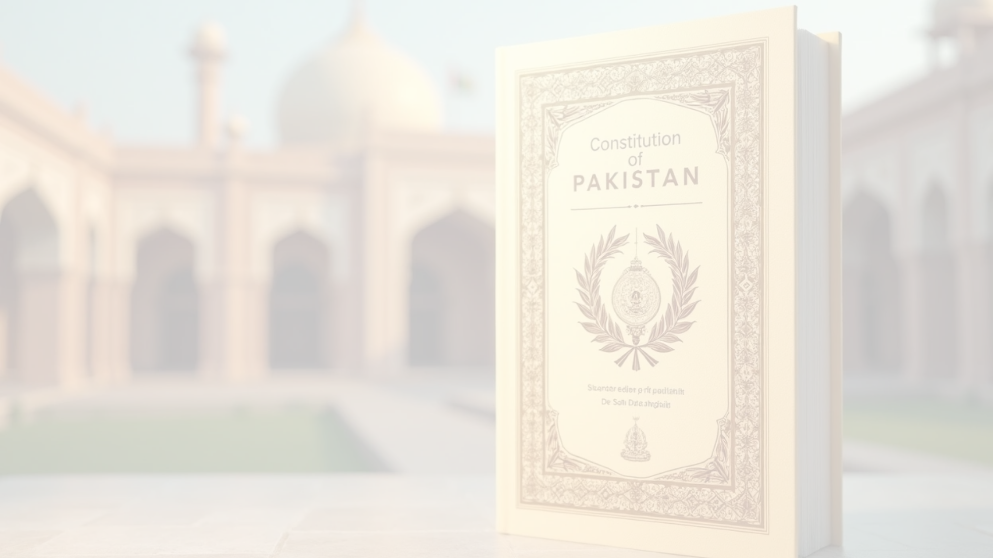
Introduction
"A landmark achievement of Zulfikar Ali Bhutto's leadership was the establishment of the 1973 Constitution, which was built on a foundation of political consensus. By accommodating proposals from the opposition, the constitution gained the acceptance of almost every major political party. Following its approval by the National Assembly on April 10, 1973, the constitution came into force on August 14. This date also marked the transition of Zulfikar Ali Bhutto to the role of Prime Minister and the appointment of Fazal Ilahi Chaudhry as President."
For over five decades, the Constitution of the Islamic Republic of Pakistan, enacted in 1973, has served as the nation's supreme law. A product of consensus among elected representatives, this foundational document outlines the state's structure, guarantees fundamental rights to its citizens, and weaves Islamic principles into the fabric of its governance.

Slide 5
02
Distribution of 1973

Slide 6

Preamble
The Preamble sets out the ideals and objectives of the Constitution. It acknowledges the sovereignty of Allah, affirms the principles of democracy, freedom, equality, and social justice as enunciated by Islam, and resolves to create a state where Muslims can order their lives according to the teachings of the Holy Qur'an and Sunnah, while safeguarding the rights of minorities.

Slide 7











Part I: Introductory (Articles 1-6)
This part establishes the foundational elements of the state.
1
2
3
Article 1
Article 2
Article 3
Defines the country as the "Islamic Republic of Pakistan" and lists its territories.
Declares Islam as the state religion.
Commits the state to eliminating all forms of exploitation.
4
5
Article 4
Article 6
Guarantees every citizen the right to be treated in accordance with the law.
Defines the act of subverting the Constitution as high treason.

Slide 8



Part II: Fundamental Rights and Principles of Policy (Articles 7-40)
This crucial part is divided into two chapters, outlining the rights of citizens and the guiding principles for the state.
Chapter 1
Chapter 2
Fundamental Rights (Articles 8-28)
Principles of Policy (Articles 29-40)
• Brief: These are legally enforceable (justiciable) rights guaranteed to every citizen. They include the security of person, prohibition of slavery and forced labor, freedom of movement, assembly, association, speech, and religion, equality of citizens, right to property, and the right to education.
• Brief: These are aspirational goals and guidelines for the state to follow when making laws and policies. While not directly enforceable in court, they are a constitutional directive to promote an Islamic way of life, social justice, and the economic well-being of the people.

Slide 9
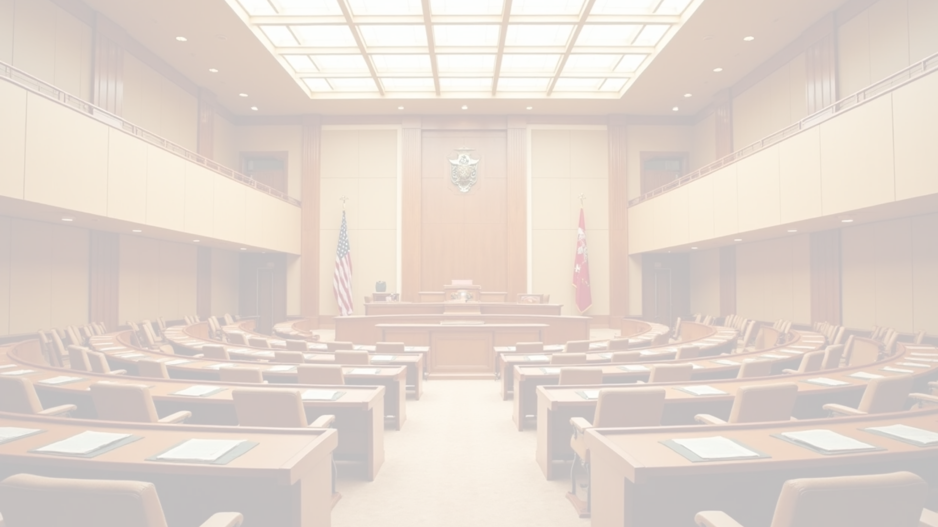




Part III: The Federation of Pakistan (Articles 41-100)
This part details the structure and powers of the federal government.
1
Chapter 1
The President (Articles 41-49)
• Brief: Outlines the qualifications, election, term of office, and functions of the President as the ceremonial Head of State.
2
Chapter 2
The Majlis-e-Shoora (Parliament) (Articles 50-89)
• Brief: Describes the bicameral federal legislature, consisting of the National Assembly (lower house) and the Senate (upper house). It covers their composition, election of members, duration, legislative procedures (how a bill becomes law), and financial procedures like the annual budget.
3
Chapter 3
The Federal Government (Articles 90-100)
• Brief: Focuses on the executive branch, headed by the Prime Minister. It details the formation of the Federal Cabinet, the functions of the Prime Minister as the chief executive, and the conduct of government business.

Slide 10
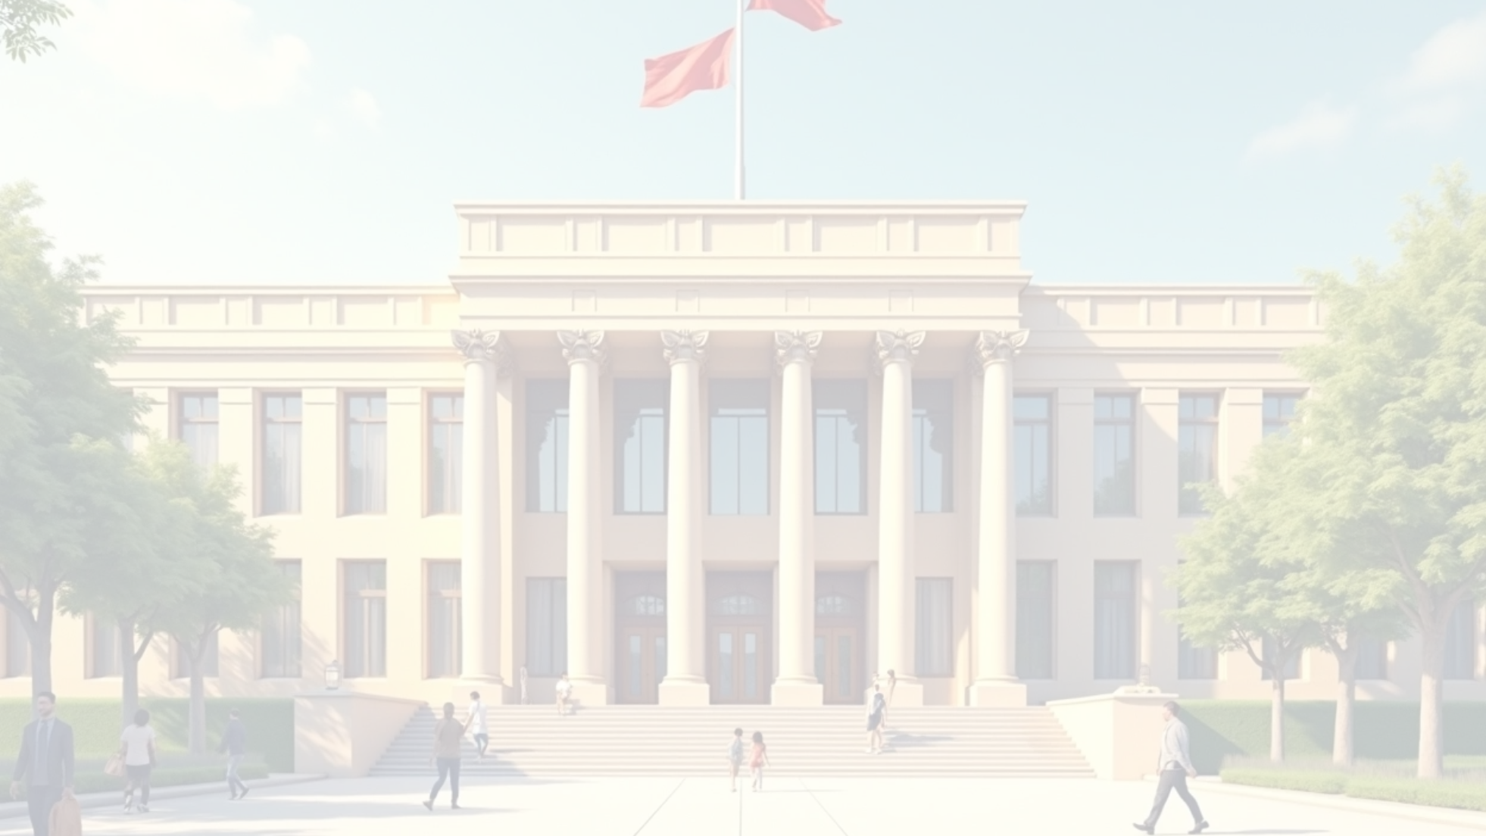



Part IV: Provinces (Articles 101-140A)
This part mirrors the federal structure at the provincial level.
Chapter 1
Chapter 2
Chapter 3
The Governors (Articles 101-105)
Provincial Assemblies (Articles 106-128)
The Provincial Governments (Articles 129-140A)
• Brief: Details the appointment, qualifications, and role of the Governor as the head of the province.
• Brief: Outlines the composition, duration, and functioning of the provincial legislatures, including their law-making and financial powers.
• Brief: Describes the provincial executive, headed by the Chief Minister, and the formation and functions of the provincial cabinet.

Slide 11
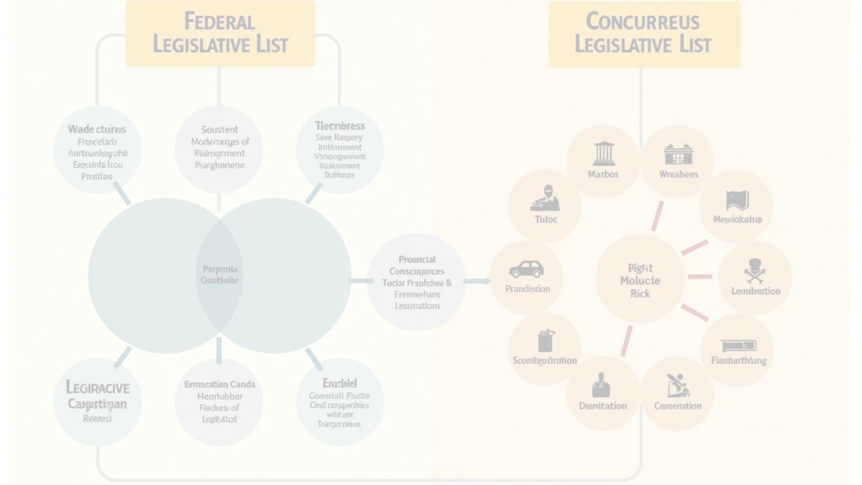





Part V: Relations Between Federation and Provinces (Articles 141-159)
This section manages the complex relationship and division of powers in the federal system.
1
Chapter 1
2
Chapter 2
3
Chapter 3
Distribution of Legislative Powers (Articles 141-144)
Administrative Relations (Articles 145-152)
Special Provisions (Articles 152A-159)
• Brief: Explains which subjects Parliament can legislate on (the Federal Legislative List) and which subjects both federal and provincial assemblies can legislate on (the Concurrent Legislative List).
• Brief: Provides for cooperation and coordination between the federal and provincial governments.
• Brief: Establishes key inter-provincial bodies like the Council of Common Interests (CCI) and the National Economic Council (NEC) to resolve disputes and coordinate economic planning.

Slide 12


Part VI: Finance, Property, Contracts and Suits (Articles 160-174)
Brief
This part deals with the financial machinery of the state. It establishes the National Finance Commission (NFC) for the distribution of revenues between the federation and provinces, outlines the rules for federal and provincial funds, and provides for the office of the Auditor-General of Pakistan.

Slide 13
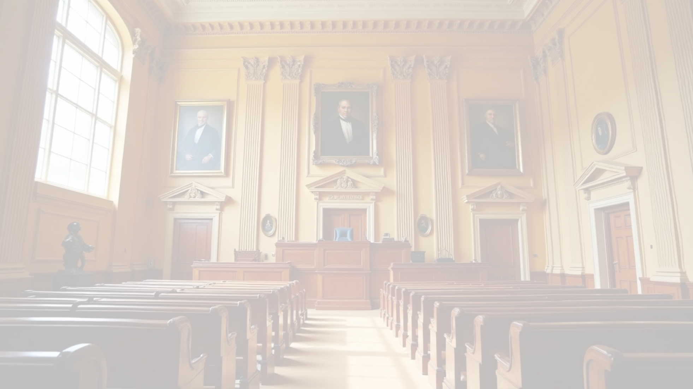









Part VII: The Judicature (Articles 175-212)
This part details the structure, powers, and independence of the judicial branch.
1
2
Chapter 1
Chapter 2
The Courts (Article 175)
The Supreme Court of Pakistan (Articles 176-191)
• Brief: Establishes the Supreme Court, High Courts, and other subordinate courts.
• Brief: Defines the composition, appointment of judges, and jurisdiction (original, appellate, advisory) of the highest court in the country.
3
4
Chapter 3
Chapter 3A
The High Courts (Articles 192-203)
Federal Shariat Court (Articles 203A-203J)
• Brief: Describes the composition, appointment of judges, and jurisdiction of the High Courts at the provincial level.
• Brief: Establishes a court with the specific power to examine and decide whether any law or provision is repugnant to the injunctions of Islam.
5
Chapter 4
General Provisions Relating to the Judicature (Articles 204-212)
• Brief: Contains general rules for the judiciary, including the establishment of the Supreme Judicial Council (for the accountability of judges) and Administrative Courts and Tribunals.

Slide 14
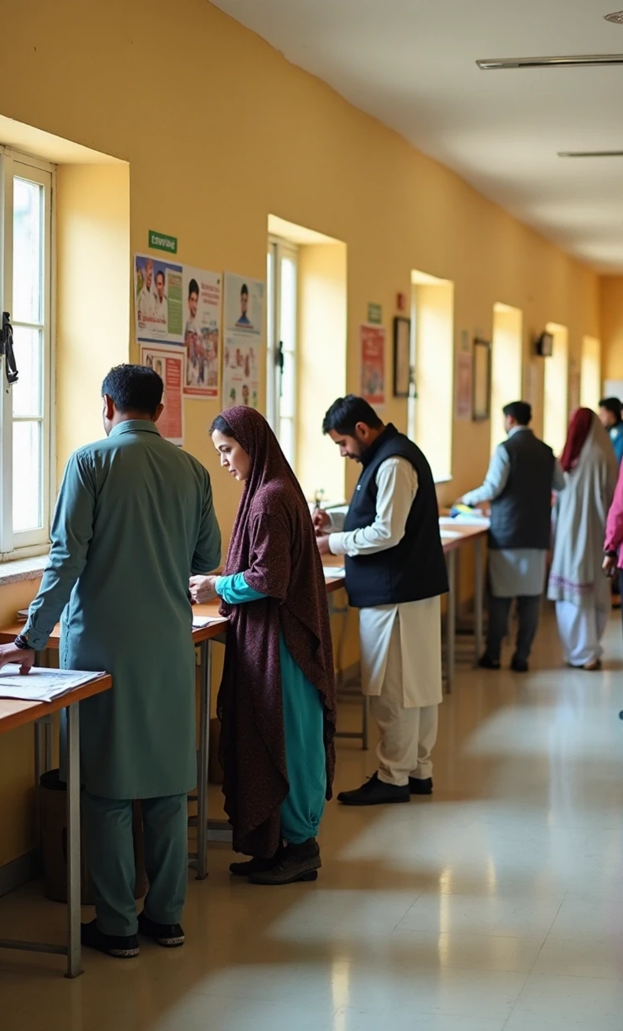

Part VIII: Elections (Articles 213-226)
Brief
This part lays out the framework for free and fair elections. It establishes the Election Commission of Pakistan (ECP), detailing its composition, duties, and the constitutional principles that govern the electoral process.

Slide 15


Part IX: Islamic Provisions (Articles 227-231)
Brief
This section reinforces the Islamic character of the state. It mandates that all existing laws shall be brought into conformity with the injunctions of Islam and establishes the Council of Islamic Ideology (CII) to advise the legislature on Islamic matters.

Slide 16

Part X: Emergency Provisions (Articles 232-237)
Brief
This part outlines the procedures for the state to deal with extraordinary situations. It allows the President, on the advice of the Prime Minister, to proclaim an emergency in case of war, internal disturbance, or financial crisis, which can lead to the temporary suspension of certain fundamental rights.

Slide 17


Part XI: Amendment of Constitution (Articles 238-239)
Brief
This section specifies the rigid process for amending the Constitution, which requires a bill to be passed by a two-thirds majority in both the National Assembly and the Senate.

Slide 18




Part XII: Miscellaneous (Articles 240-280)
This final part is a collection of various provisions essential for the functioning of the state.
Chapter 1
Chapter 2
Services (Articles 240-242): Deals with the civil services of Pakistan.
Armed Forces (Articles 243-245): Defines the command structure and functions of the military.
Chapter 3
Chapter 4
Tribal Areas (Articles 246-247): (Largely historical now after the 25th Amendment merged FATA with Khyber Pakhtunkhwa).
General (Articles 248-259): Includes provisions on national language (Urdu), and protections for the President and Governors.
Chapter 5
Chapter 6
Interpretation (Articles 260-264): Provides definitions for key terms used throughout the document.
Title, Commencement and Repeal (Articles 265-266): Formal clauses for the Constitution's name and enactment.
Chapter 7
Transitional (Articles 267-280): Provisions that managed the transition of power and laws when the Constitution was first enacted.

Slide 19
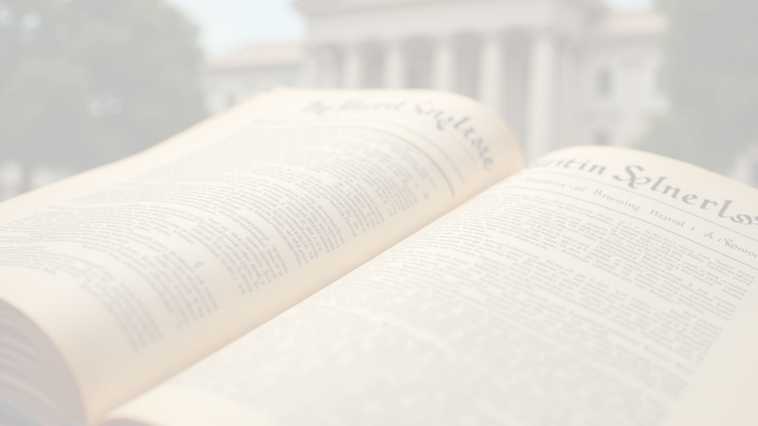




Schedules
The schedules are lists that supplement the main articles of the Constitution.
1
First Schedule
2
Second Schedule
Lists laws exempted from the operation of Article 8(1) and (2).
Pertains to the election of the President.
3
Third Schedule
4
Fourth Schedule
Contains the Oaths of Office for various constitutional positions.
Contains the Federal Legislative List.
5
Fifth Schedule
Pertains to the remuneration and terms of judges.

Slide 20
03
Some Salient Features

Slide 21










Some Salient Features
The 1973 Constitution is a comprehensive written document, comprising 280 articles and seven schedules. It establishes Pakistan as a federal parliamentary republic, a significant departure from the presidential system of the 1962 constitution. Key features include:
1
2
Federal System
Parliamentary Form of Government
The constitution establishes a federal structure, dividing powers between the central government and the provinces. This is intended to ensure provincial autonomy while maintaining national unity.
Executive authority is vested in the Prime Minister, who is the head of government and accountable to the National Assembly. The President acts as the ceremonial head of state.
3
4
Bicameral Legislature
Fundamental Rights
The Parliament, known as the Majlis-e-Shoora, is bicameral, consisting of the National Assembly (the lower house) and the Senate (the upper house). The National Assembly is elected through direct popular vote, while the Senate provides equal representation to the provinces.
A comprehensive chapter on fundamental rights is a cornerstone of the constitution. These rights are legally enforceable and any law inconsistent with them can be declared void by the judiciary.
5
6
Independent Judiciary
National Language
The constitution provides for an independent judiciary to safeguard the rights of citizens and ensure that all organs of the state function within the constitutional framework.
Urdu is declared the national language, with provisions for the promotion of regional languages. English is retained as the official language for a specified period.
7
Rigid Constitution
The process for amending the constitution is intentionally rigorous, requiring a two-thirds majority in both houses of Parliament.

Slide 22
04
The Islamic Framework of the 1973 Constitution

Slide 23










The Islamic Framework of the 1973 Constitution
The 1973 Constitution formally establishes Pakistan's identity as an Islamic republic, with its laws and principles guided by the Holy Qur’an and Sunnah. Key Islamic provisions include:
1
2
3
4
National Identity
Divine Sovereignty
Leadership Requirements
Promotion of an Islamic Lifestyle
The official name of the country is the "Islamic Republic of Pakistan," with Islam designated as the state religion.
The constitution acknowledges that absolute sovereignty belongs to Almighty Allah. The authority delegated to the people of Pakistan is a sacred trust, to be exercised within the boundaries set by the Qur’an and Sunnah.
It is mandatory for the President and the Prime Minister of Pakistan to be Muslim. The constitution defines a Muslim as one who believes in the oneness of Allah (Tauheed) and in the finality of the Prophethood of Hazrat Muhammad (PBUH).
The state is responsible for creating conditions that enable the Muslims of Pakistan to organize their lives, both individually and collectively, according to the fundamental principles of Islam.
5
6
7
8
Societal and Moral Guidance
Educational Mandates
Foreign Policy
The Council of Islamic Ideology (CII)
The state is directed to promote social justice and eradicate social evils. This includes preventing activities such as prostitution, gambling, the consumption of intoxicants, and the circulation of obscene materials.
The state is required to make the teaching of the Holy Qur’an and Islamic Studies compulsory and to facilitate the learning of the Arabic language.
The constitution obligates the state to strengthen fraternal relations among Muslim countries to promote Islamic unity.
This constitutional body is tasked with advising the government on Islamic teachings and their implementation. While its recommendations are not legally binding, they carry significant influence and are not easily disregarded.
9
10
Sanctity of the Holy Qur'an
Oath of Office
The state must ensure the accurate and error-free printing and publication of the Holy Qur'an.
High-ranking officials, including ministers, speakers, and governors, must take an oath to preserve, protect, and promote Pakistan's Islamic ideology.

Slide 24
05
Advantages for Citizens: A Charter of Rights and Freedoms Explained with Constitutional Articles

Slide 25

Advantages for Citizens: A Charter of Rights and Freedoms Explained with Constitutional Articles
The fundamental rights guaranteed in Part II, Chapter 1 of the Constitution are the primary source of these advantages. They are legally enforceable, meaning a citizen can petition the High Court or Supreme Court if these rights are violated.

Slide 26


Equality and Non-Discrimination
This principle ensures that every citizen is treated equally by the state and the law, without unfair bias.
Article 25
Equality of citizens.
• Explanation: This is the cornerstone of equality in Pakistan. Clause (1) states, "All citizens are equal before law and are entitled to equal protection of law." This means the law applies to everyone in the same way, regardless of their status. Clause (2) explicitly prohibits discrimination based on sex. While it only mentions sex, the broader principle of non-discrimination is reinforced in other articles, such as those related to public access and employment (Articles 26 & 27), which prohibit discrimination on grounds of race, religion, caste, sex, residence, or place of birth.

Slide 27

Freedom of Speech, Assembly, and Association
These articles provide the essential freedoms for a functioning democracy, allowing citizens to express themselves, protest, and form political or social groups.
1
Article 19
2
Article 16
3
Article 17
Freedom of speech, etc.
Freedom of assembly.
Freedom of association.
• Explanation: This article grants every citizen "the right to freedom of speech and expression, and freedom of the press," subject to reasonable legal restrictions for reasons like the glory of Islam, national security, public order, or morality.
• Explanation: This guarantees every citizen the "right to assemble peacefully and without arms," again subject to reasonable restrictions imposed by law in the interest of public order.
• Explanation: This article gives every citizen the "right to form associations or unions," which is the constitutional basis for political parties, trade unions, and non-governmental organizations (NGOs).

Slide 28



Freedom of Religion
The constitution guarantees religious freedom not just to the Muslim majority but to all citizens, protecting their right to practice their faith.
Article 20
Article 22
Freedom to profess religion and to manage religious institutions.
Safeguards as to educational institutions in respect of religion, etc.
• Explanation: This article is the primary guarantee of religious freedom. It states that every citizen has the right to "profess, practice and propagate his religion," and every religious denomination has the right to "establish, maintain and manage its religious institutions."
• Explanation: This article reinforces religious freedom in the context of education. It ensures that no person can be forced to receive religious instruction in a faith other than their own and allows religious communities to provide religious education to pupils of their own faith in any educational institution they maintain.

Slide 29






Right to Life and Liberty
This is one of the most fundamental rights, protecting citizens from unlawful deprivation of their life or freedom by the state.
1
2
Article 9
Article 10
Security of person.
Safeguards as to arrest and detention.
• Explanation: This concise but powerful article states, "No person shall be deprived of life or liberty save in accordance with law." This means the government cannot harm or imprison anyone arbitrarily; it must follow a proper and established legal procedure.
• Explanation: This article provides specific protections for arrested individuals. It includes the right to be informed of the grounds for arrest, the right to consult and be defended by a lawyer, and the right to be produced before a magistrate within 24 hours of arrest.

Slide 30


Right to Property
This right ensures that citizens can own property and are protected from its arbitrary seizure by the state.
Article 23
Article 24
Provision as to property.
Protection of property rights.
• Explanation: This article grants every citizen the "right to acquire, hold and dispose of property in any part of Pakistan."
• Explanation: This article protects citizens from the state compulsorily acquiring their private property, except for a public purpose and only after paying fair compensation as determined by law.

Slide 31


Right to Education
This is a key socio-economic right, making education a fundamental entitlement for every child.
Article 25-A
Right to education.
• Explanation: Introduced by the 18th Amendment, this article makes education a fundamental, enforceable right. It mandates that "The State shall provide free and compulsory education to all children of the age of five to sixteen years in such manner as may be determined by law."

Slide 32



Safeguards for Minorities
The constitution contains several provisions specifically aimed at protecting the rights and interests of non-Muslim citizens.
Article 36: Protection of minorities.
In addition to Article 20 (Freedom of Religion), other articles also serve as safeguards, including provisions in Article 51 and Article 106 that reserve seats for non-Muslims in the National and Provincial Assemblies, ensuring their political representation.
• Explanation: This article, part of the "Principles of Policy," explicitly directs the state to "safeguard the legitimate rights and interests of minorities, including their due representation in the Federal and Provincial services."

Slide 33
06
Real-Life Examples

Slide 34

Real-Life Examples
Here are some real-life examples of how the constitutional rights and principles can be practically useful for an ordinary person in Pakistan.

Slide 35



Equality and Non-Discrimination (Article 25)
1
Scenario
2
How the Constitution Helps
A highly qualified woman applies for a management position at a private company. After the interview, she is told that while she was an excellent candidate, the company has a policy of hiring men for leadership roles because they believe men are "better suited to command."
This is a clear violation of Article 25, which prohibits discrimination on the basis of sex. The woman can file a lawsuit against the company. Her legal argument would be based on her fundamental right to equality and equal protection under the law. The constitution provides the legal foundation for her to challenge this discriminatory practice and seek justice.

Slide 36



Right to Life & Liberty / Safeguards Against Arrest (Articles 9 & 10)
Scenario
The police show up at a young man's house and take him into custody without telling him or his family why. He is held at the police station for two days with no information.
How the Constitution Helps
The man's family can immediately take action based on Article 10.
• They can hire a lawyer who has the right to see the detained person.
• The lawyer can file an urgent "habeas corpus" petition in the High Court under Article 199 (Access to Justice).
• This petition enforces the rights in Article 10, specifically the right to be produced before a magistrate within 24 hours. The court will order the police to immediately bring the man to court and provide a legal justification for his detention. This prevents illegal detentions and "disappearances."

Slide 37




Freedom of Speech (Article 19)
1
2
Scenario
How the Constitution Helps
A citizen is frustrated with the constant garbage pile-up on their street. They create a social media page to document the problem, posting pictures and criticizing the local municipal authority for its negligence. An official from the authority calls them and threatens them with legal action if they don't shut the page down.
The citizen is protected by Article 19. As long as their criticism is not inciting violence or hatred (within the reasonable restrictions), their right to freedom of speech allows them to highlight civic issues and hold public officials accountable. The official's threat is an attempt to curb this constitutional right.

Slide 38


Right to Property (Article 24)
Scenario
How the Constitution Helps
The government announces a plan to widen a road, and a portion of an elderly couple's house, which they have owned for 50 years, is marked for demolition. The government initially offers them a very small, below-market-value amount of money as compensation.
Article 24 states that property cannot be compulsorily acquired except for a public purpose and, crucially, only by a law that provides for fair compensation. The couple can go to court and argue that the offered amount is not "fair compensation." The court can then order a proper valuation of the property and compel the government to pay the fair market price, ensuring the couple is not unjustly deprived of their lifelong investment.

Slide 39





Right to Education (Article 25-A)
1
Scenario
A family in a rural village wants to send their 10-year-old daughter to school. The only government school in the area is non-functional; the building is there, but no teachers show up, and no classes are held.
2
How the Constitution Helps
The parents, or a social welfare organization on their behalf, can file a petition in the High Court. They will argue that the state is violating the child's fundamental right to education under Article 25-A. The court has the power to order the provincial education department to make the school functional, appoint teachers, and ensure that the state fulfills its constitutional obligation to provide free and compulsory education.

Slide 40



Access to Justice / Rule of Law (Articles 4 & 199)
Scenario
How the Constitution Helps
You have submitted all the necessary documents to the local land registry office to have a property transferred to your name. The official in charge keeps delaying the process without any valid reason, hinting that a bribe would speed things up.
You are being denied your right under Article 4 to be "treated in accordance with law." The official's action is arbitrary and illegal. You can file a writ petition in the High Court under Article 199. The court can issue a "writ of mandamus"—an order compelling the public official to perform their legal duty and finalize the property transfer, thereby enforcing the rule of law and providing you access to justice.

Slide 41
07
Aspects in Daily Life: The Constitution in Action

Slide 42

Aspects in Daily Life: The Constitution in Action
The principles and provisions of the 1973 Constitution have a tangible impact on the daily lives of Pakistanis:

Slide 43
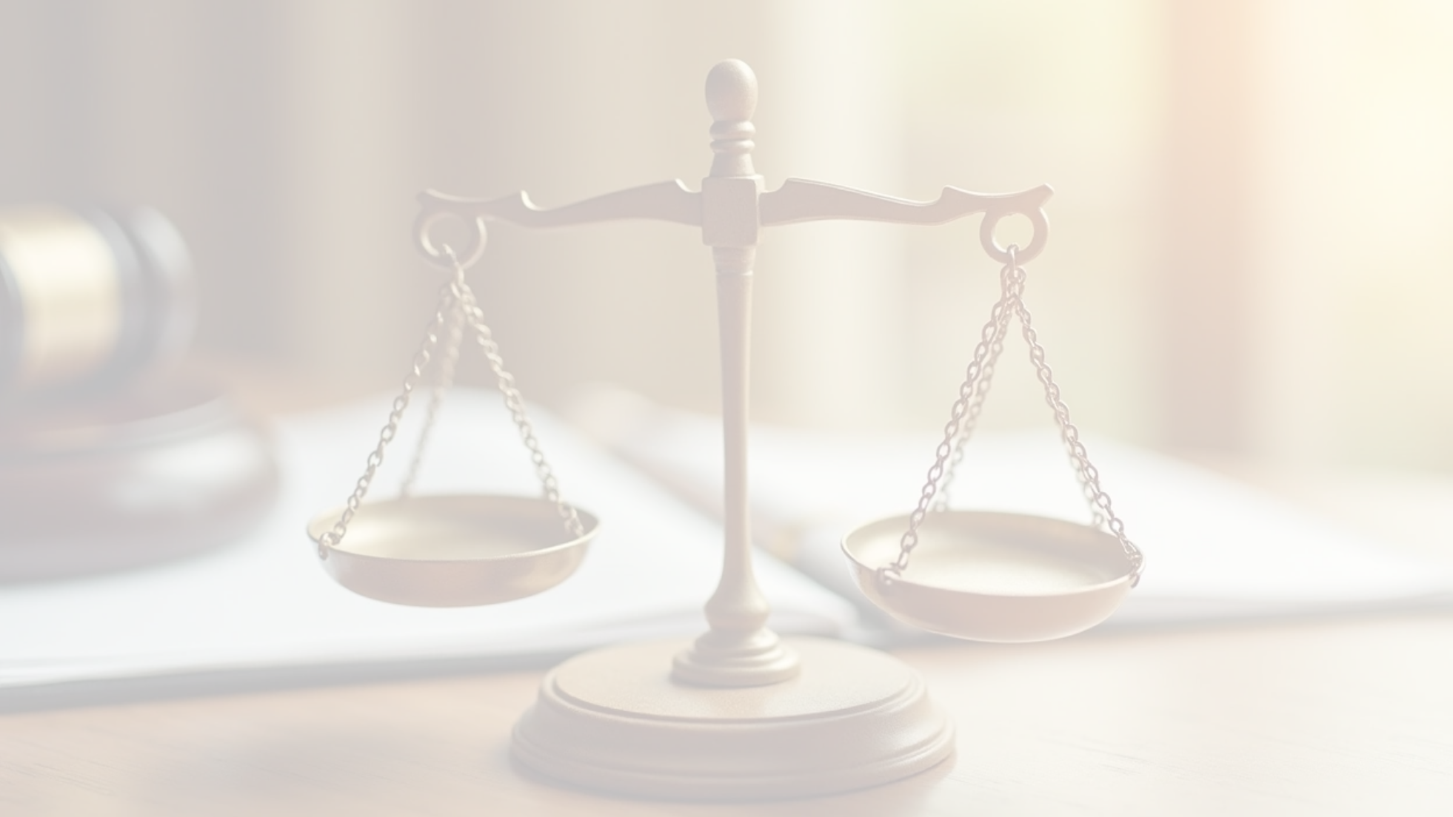




Rule of Law
The principle that no one is above the law and everyone is subject to the same legal standards is a cornerstone of the constitution, primarily established by the following articles:
1
Article 4
2
Article 25
Right of individuals to be dealt with in accordance with law, etc.
Equality of citizens.
• Explanation: This article reinforces the rule of law by ensuring it applies to everyone equally. It states that "all citizens are equal before the law and are entitled to equal protection of law." It also explicitly prohibits discrimination on the basis of sex. This means that the law, in theory, should be applied with the same standards to a powerful politician as it is to an ordinary citizen, ensuring fairness and preventing the abuse of power.
• Explanation: This is arguably the most fundamental article for the rule of law. It states that every citizen has an "inalienable right" to be treated in accordance with the law. It explicitly says that no action can be taken against a person's life, liberty, body, reputation, or property unless it is legally justified. In daily life, this means a government official cannot arbitrarily seize your property, and the police cannot detain you without legal cause. It establishes that all state actions must have a legal basis.

Slide 44



Political Participation
The ability of citizens to participate in governing the country through voting and political parties is guaranteed by these articles:
Article 51 (National Assembly) & Article 106 (Constitution of Provincial Assemblies):
Article 17: Freedom of association.
• Explanation: This article gives every citizen the right to "form or be a member of a political party," subject to reasonable restrictions in the interest of Pakistan's sovereignty. This is crucial for political participation beyond just voting. It allows citizens to organize, campaign, and collectively advocate for their political beliefs, which is the foundation of a multi-party democratic system.
• Explanation: These articles establish the directly elected houses of the federal and provincial legislatures. They stipulate that members shall be chosen by "direct and free vote in accordance with law" based on the principle of adult franchise (the right of adults to vote). This is the constitutional mechanism that creates elections, turning the abstract idea of democracy into the practical act of voting that citizens experience.

Slide 45






Access to Justice
The ability for citizens to seek redress for their grievances and challenge the state is made possible by the powers granted to the independent judiciary:
1
2
Article 199
Article 175
Jurisdiction of High Court.
Establishment and jurisdiction of courts.
• Explanation: This is the primary tool for citizens to seek justice against the state. It grants the High Courts the power of "writ jurisdiction," allowing them to issue orders to any person or authority (including the government) to enforce the Fundamental Rights guaranteed in the constitution. If a citizen believes a government action has violated their rights, they can file a petition in a High Court under this article. This makes the judiciary an accessible forum for holding the government accountable.
• Explanation: This article formally establishes the judiciary of Pakistan, including the Supreme Court, High Courts, and other subordinate courts. It lays the groundwork for an independent judiciary "which shall be separated progressively from the Executive." This separation is critical for ensuring that courts can make impartial decisions without government pressure, giving citizens confidence that their cases will be heard fairly.

Slide 46


Social and Economic Justice
The constitution guides the state to work towards the well-being of its people through a dedicated chapter, even if its provisions are not directly enforceable in court.
Chapter 2
Principles of Policy (Articles 29-40)
• Explanation: This entire chapter serves as a constitutional guideline for all government bodies. While you cannot sue the government for failing to follow these principles, they impose a moral and political duty on the state. Key articles include:
• Article 37 (Promotion of social justice and eradication of social evils): This directs the state to make education available, secure just and humane conditions of work (especially for women and children), and provide legal aid to poor citizens.
• Article 38 (Promotion of social and economic well-being of the people): This instructs the state to prevent the concentration of wealth, provide basic necessities like food, clothing, housing, education, and medical care for all citizens, and reduce inequality. These principles shape government policy on everything from labor laws to public health and education budgets.

Slide 47




Protection of Culture and Language
The constitution ensures that Pakistan's diverse communities can preserve their unique identities.
1
2
Article 28
Article 251
Preservation of language, script and culture.
National language.
• Explanation: This is a direct and powerful guarantee. It states that any section of citizens "having a distinct language, script or culture shall have the right to preserve and promote the same and establish institutions for that purpose." This is the article that constitutionally protects the daily use of regional languages like Sindhi, Pashto, Balochi, and Punjabi, and allows communities to run their own cultural centers and schools.
• Explanation: While this article establishes Urdu as the national language, it also explicitly allows Provincial Assemblies to pass laws for the teaching and promotion of provincial languages alongside Urdu. This provides a legal framework for provincial governments to actively support and preserve the languages spoken in their regions, reflecting the country's linguistic diversity in official life.

Slide 48
08
Amendments

Slide 49
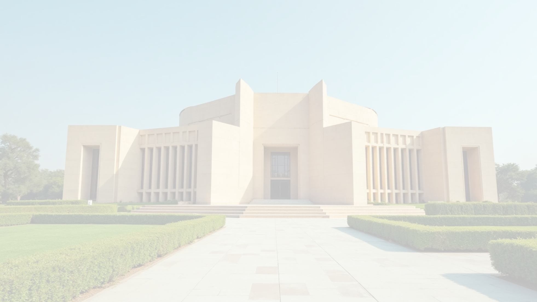
Amendments
The 1973 Constitution of the Islamic Republic of Pakistan has been amended 26 times. The most recent of these, the 26th Amendment, was passed in October 2024 and focuses on reforms within the judicial system.
Throughout its history, the constitution has undergone significant changes that have reflected the country's evolving political landscape. While some amendments have aimed to strengthen democratic institutions and devolve power to the provinces, others have expanded presidential powers.
It is worth noting that while 26 amendments have been successfully passed by Parliament, a few others have been proposed but did not complete the legislative process.

Slide 50




First Amendment
Enacted in May 1974, the First Amendment made several significant adjustments to the constitution. The most important changes were:
Redefinition of Territories
Regulation of Political Parties
Limited High Court Jurisdiction
It formally redefined the territories of Pakistan, explicitly listing the four provinces, the Islamabad Capital Territory, the Federally Administered Tribal Areas (FATA), and any other states that might join in the future.
It placed new restrictions on political parties. The amendment gave the federal government the power to declare a party unlawful if it was deemed to be operating against the nation's sovereignty or integrity. The final decision on such a declaration would rest with the Supreme Court. It also required parties to legally account for their funding sources.
The amendment restricted the power of High Courts, preventing them from hearing cases filed by members of the Armed Forces concerning their service matters or actions taken in their official capacity.
Other notable changes included adjusting the minimum required session days for the legislature and making several technical clarifications regarding the appointment and transfer of judges and the scope of administrative tribunals.

Slide 51
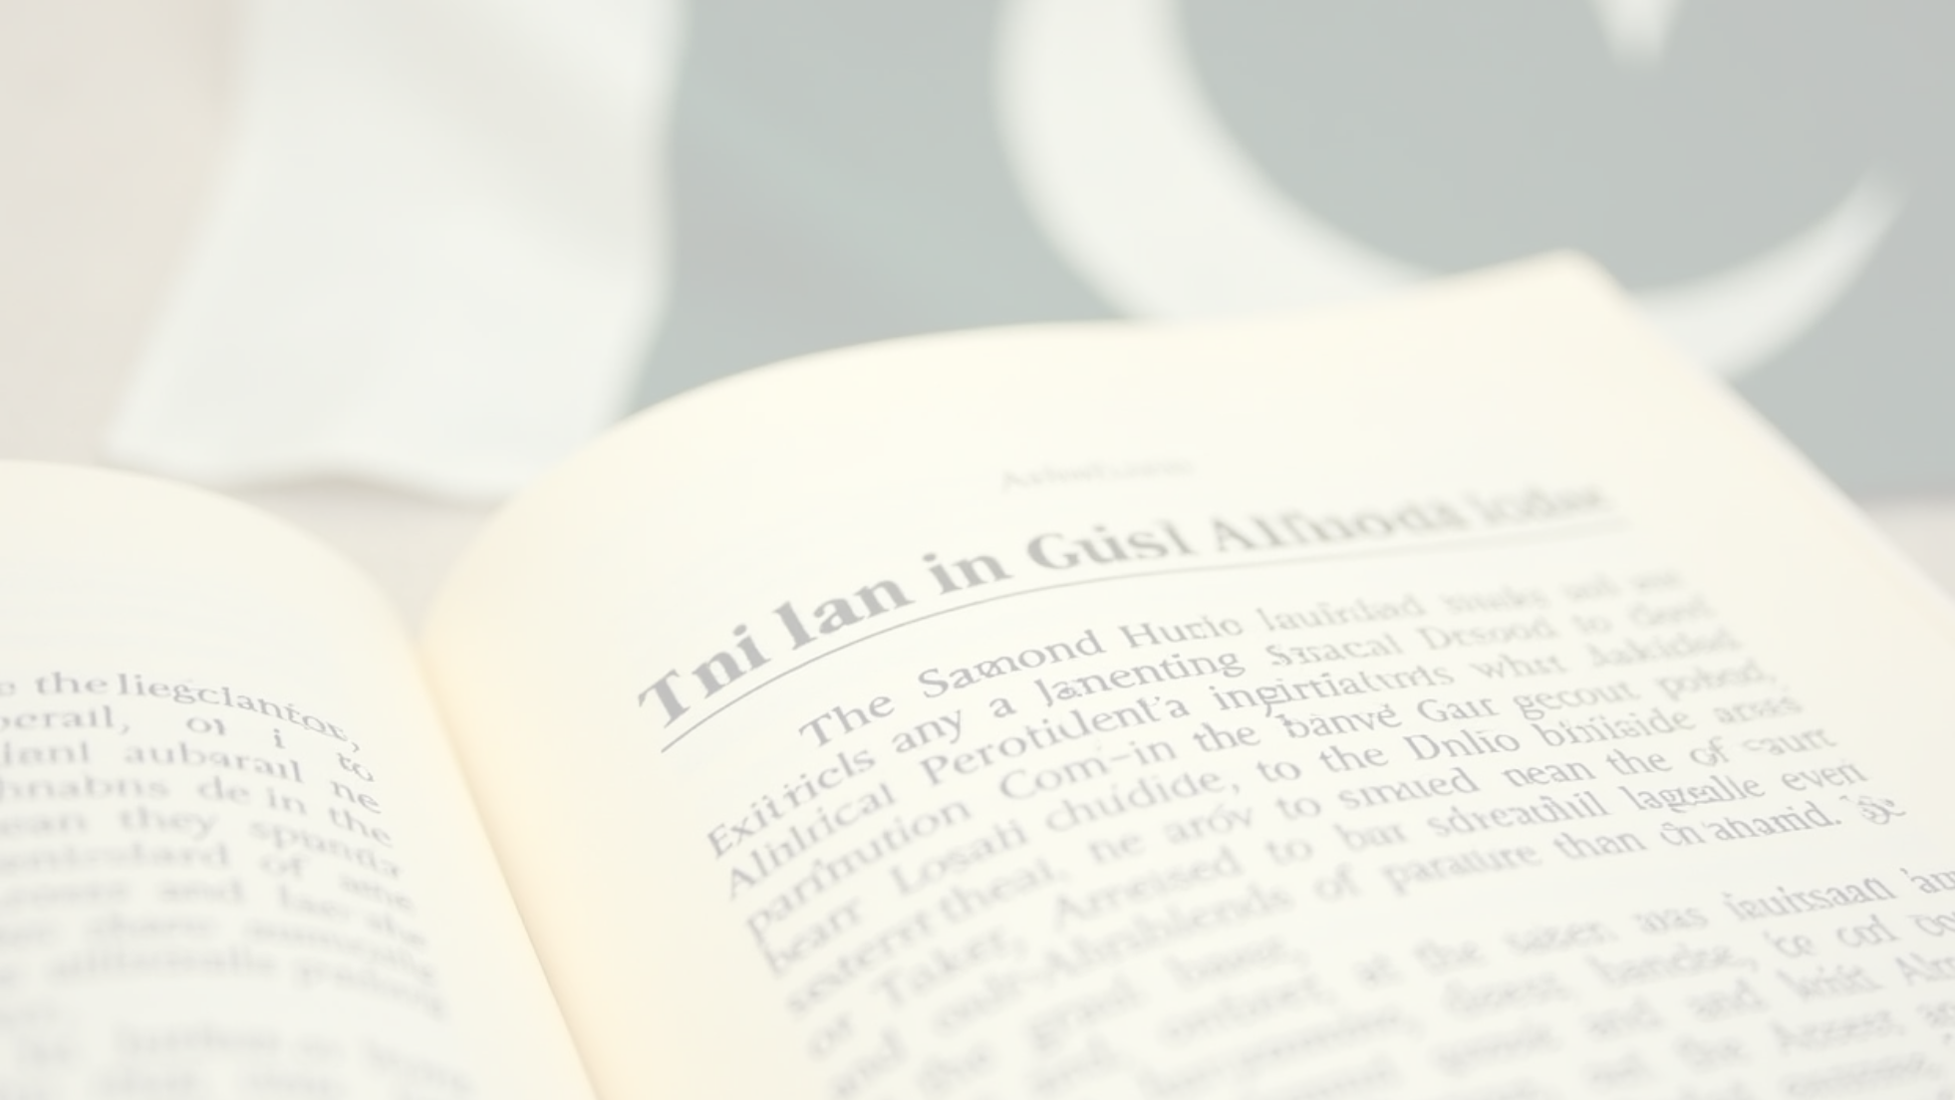





Second Amendment
Passed in September 1974, the Second Amendment formally declared persons belonging to the Ahmadiyya community as non-Muslims for the purposes of Pakistan's constitution and law.
It did this by:
1
Amending Article 260
2
Amending Article 106
It added a clause that defines a Muslim as someone who believes in the "absolute and unqualified finality of the Prophethood of Muhammad (PBUH)." Consequently, anyone who does not hold this belief is legally considered a non-Muslim.
It specifically listed the "Qadiani group or the Lahori group (who call themselves 'Ahmadis')" as a distinct non-Muslim minority community for the purpose of representation in provincial assemblies.
Some of the most transformative amendments include:
1
The Eighth Amendment (1985), which shifted the form of government from a parliamentary system to a semi-presidential system.
2
The Thirteenth Amendment (1997), which reversed many of the changes made by the Eighth Amendment, strengthening the role of the Prime Minister.
3
The Seventeenth Amendment (2003), which again increased presidential powers.
4
The Eighteenth Amendment (2010), a landmark amendment that returned the country to a parliamentary republic and granted greater autonomy to the provinces.
5
The Twenty-fifth Amendment (2018), which merged the Federally Administered Tribal Areas (FATA) with the province of Khyber Pakhtunkhwa.

Slide 52
09
Conclusion: A Resilient Framework Facing Modern Challenges

Slide 53
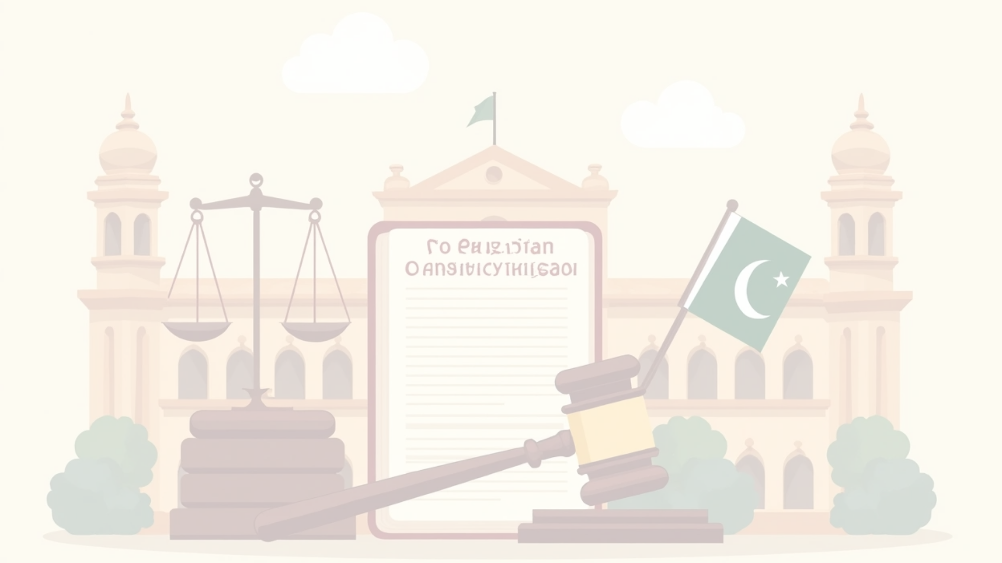
Conclusion: A Resilient Framework Facing Modern Challenges
The 1973 Constitution of Pakistan stands as a testament to the nation's aspiration for a democratic, federal, and Islamic state. It has provided a framework for governance for over half a century, weathering political storms and periods of military rule. Its comprehensive enumeration of fundamental rights provides a legal basis for citizens to demand justice and equality.
However, the journey of constitutionalism in Pakistan has not been without its challenges. The implementation of its provisions has often been a subject of debate and contention. The balance between its Islamic and democratic clauses continues to be a defining feature of the nation's political discourse.
In conclusion, the 1973 Constitution remains the cornerstone of Pakistan's legal and political system. Its enduring relevance lies in its ability to provide a framework for the rule of law, the protection of fundamental rights, and the functioning of democratic institutions. As Pakistan navigates the complexities of the 21st century, the spirit and letter of its constitution will continue to be the ultimate guide for its leaders and citizens alike.

Slide 54

Thank You

